Slide 1

AWS Architecture Icons
Release 1-2018.10.09

Slide 2
What’s changed?
You may notice a few changes and updates in this deck since the last release of the Simple Icon deck:
New look You will notice updated product and simple icons, groups, and a simplified color palette in order to create a toolkit of on-brand architecture elements. This update brings the Architecture Icons into alignment with the current AWS logo and branding guidelines released in 2017.
Updated classifications Over time, this deck has had a lot of names – some know it as the “Simple Icon deck”, others as “Console icons.” Due to the evolution of products over time, we’re renaming the deck as “AWS Architecture Icons.” The deck has been reorganized to contain product icons, resource icons, and supporting elements (such as groups, arrows, and illustrations.)
Expanded product icon set Our product icon set includes expanded product offerings since the last update.
What hasn’t changed? The deck may have a new look, but it has the same components you know from before: product icons, resource icons, and groups.

Slide 3
Contents
Introduction
System
Guidelines
Elements
Examples

Slide 4

Introduction
About the deck and guidance for getting started

Slide 5
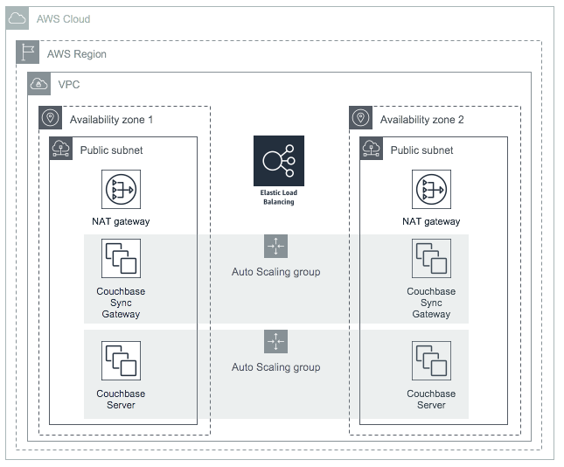
About AWS Architecture Icons
Architecture diagrams are a great way to communicate your design, deployment and topology. In this deck you will find an official collection of AWS product icons, resources, and other tools to help you build customer-focused and consistent AWS Architecture diagrams.
Customers and partners are permitted by AWS to use them to create architecture diagrams. The icons are designed to be simple so that you can easily incorporate them in your diagrams and put them in your whitepapers, presentations, datasheets, posters or any technical material you like.

Slide 6
Before you begin:
1
2
3
Check for the latest deck update
Read the guidelines
When in doubt, refer to the examples
Refer to the guidelines section for specific element guidance and best practices.
Download the latest deck from the AWS Architecture Center
Jump to the example pages for completed diagrams. Use these as a blueprint if you’re having trouble with a particular layout or object.

Slide 7
System
An all-up look at the diagram system

Slide 8





System elements
Subnet
Groups
Arrows
Illustrations
Help make it easier to digest the overall architecture by grouping objects together
Describe a flow of information or connect different parts of a diagram
Supporting elements that help contextualize your architecture
Instances
Internet
Product icons
Resource icons
General resources
Represents an AWS product or service
Represents an AWS product resource
Resources that can apply to multiple products

Slide 9







AWS Cloud
AWS Region
Layered groups
VPC
Availability zone 1
Availability zone 2
Product icon
Public subnet
Public subnet
Resource icon
NAT gateway
NAT gateway
Auto Scaling group
Auto Scaling group
Couchbase Sync Gateway
Couchbase Sync Gateway
Auto Scaling group
Couchbase Server
Couchbase Server

Slide 10
Guidelines
How to build a diagram and element guidance

Slide 11
Building a diagram
Start with the structure Determine where your diagram will be used. Websites and blogs will generally use a light background, whereas presentations tend to use a dark background. Locate the group type created for the appropriate background, then paste them onto your desired slide. To edit, double-click into the group rectangle and stretch to desired size
Add product and resource icons Navigate to the category of your desired product icon or resource, then copy and paste it into your diagram. Product and resource icons can be used on both dark and light backgrounds
Add other steps Does your diagram include external users or devices? Use the illustrations to add depth or context to your diagram. Illustrations can be used on both dark and light backgrounds
Connect the steps Use the preset arrows to connect your steps and describe a workflow.

Slide 12
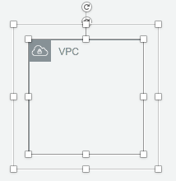
Groups
Each group consists of an icon and a label. Colors and lines help differentiate groups to make it easier for the user to read a diagram at a glance. Some groups cross multiple other groups, such as Auto Scaling, whereas others are meant to layer inside one another, such as VPC/Subnets.
Resizing groups
Layering groups
Double click into the group and select the box. Use the bottom right corner to stretch or collapse to your desired size
When you have groups within groups, each inner group should have about 0.2” buffer on each side.
DO:
Hold shift down while resizing to maintain a square
Use a generic group type if the presets do not suit your needs
VPC
Availability zone
Subnet
DON’T:
Create new group icons

Slide 13
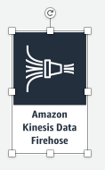
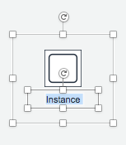
Icons
Product and resource icons are designed to be used on both dark and light backgrounds. Resource icons may be renamed to better fit a specific architecture, but product icons are not editable, as their name does not change based on the context.
Resizing product icons
Change resource icon text color
Click on the product icon, then use a corner to resize to your desired size.
DO:
When using resource icons on a dark background, be sure to change the text color to white.
Hold shift down while resizing
Change resource icon text color when using a dark background
DON’T:
Crop product icons
Flip or rotate icons

Slide 14
Arrows
Use arrows or lines to connect parts of a diagram or to show a workflow.
Use preset arrows
Creating new arrows
Copy the preset arrows into your diagram to maintain correct formatting. To edit, click on the arrow, hold down Shift
Preset arrows use the “Open Arrow” in Size 4.
DO:
Use preset arrows provided in the elements section
Use straight lines and right angles to connect objects
Default Arrow
+ Open Arrow
+ Size 4
When in doubt, use default
DON’T:
Hold Shift
If the arrow shape you need is not available in the sample arrows, go ahead and use the default arrows.
Create diagonal lines
Use anything beside preset or default arrows

Slide 15
Elements
Groups, arrows, resource icons, and product icons to use when building your diagram

Slide 16




Elements for light backgrounds
AWS Cloud
Region
VPC
Availability zone
Subnet
On-Premise
Auto Scaling group
Elastic Load Balancing
Generic group
Highlight
AWS Step Functions workflow
Spot Fleet

Slide 17










Elements for dark backgrounds
AWS Cloud
Region
VPC
Availability zone
Subnet
On-Premise
Auto Scaling group
Elastic Load Balancing
Generic group
Highlight
AWS Step Functions workflow
Spot Fleet

Slide 18






















Elements for any background
General resources
AWS Cloud
Client
Corporate data center
Disk
Forums
Generic database
Internet
Internet alt1
Internet alt2
Mobile client
Multimedia
Office building
SAML token
SSL padlock
Tape storage
Traditional server
User
Users
Virtual private cloud
Illustrations
users
notification
devices
desktop
office building

Slide 19

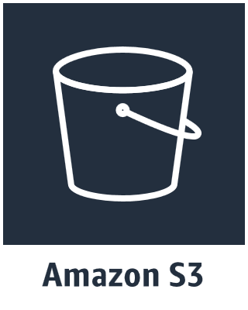


Slide 20
Product and resource icons
Click a category to jump to slide (must be in Presentation mode)
Analytics
Application Integration
AR & VR
AWS Cost Management
Business Productivity
Compute
Customer Engagement
Database
Desktop & App Streaming
Developer Tools
Game Development
Internet of Things
Machine Learning
Management Tools
Media Services
Migration
Mobile Services
Network & Content Delivery
Security, Identity, & Compliance
Storage

Slide 21







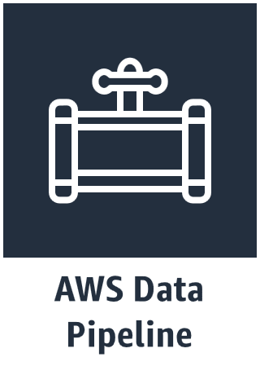


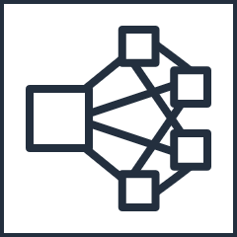









Analytics
Search documents
Cluster
EMR engine MapR M3
Dense compute node
EMR engine
HDFS cluster
Dense storage node
EMR engine MapR M5
EMR engine MapR M7

Slide 22
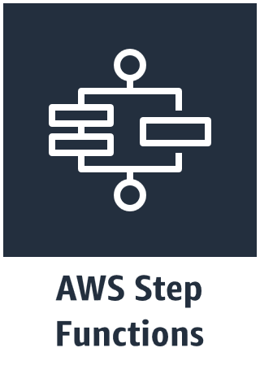



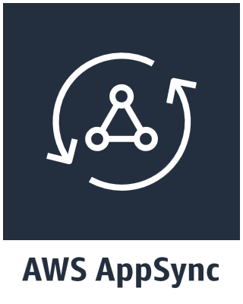





Application Integration
Email notification
Message
Queue
HTTP notification
Topic

Slide 23
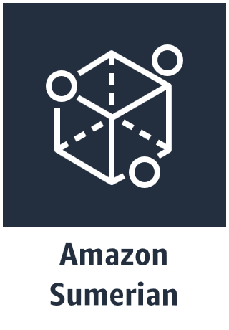



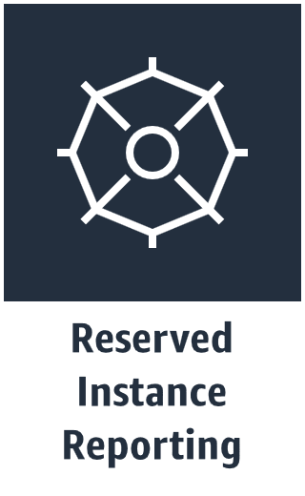

AR & VR
AWS Cost Management
Business Productivity

Slide 24







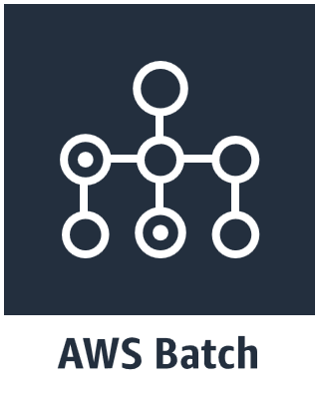









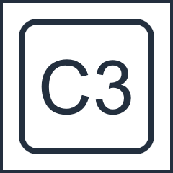





Compute
AMI
Auto Scaling
DB on Instance
Elastic IP Address
Instance with CloudWatch
Instance
Registry
Container 1
Application
Container 2
Instances
Optimized Instance
Rescue
Deployment
Container 3
Spot Instance
X1 Instance

Slide 25

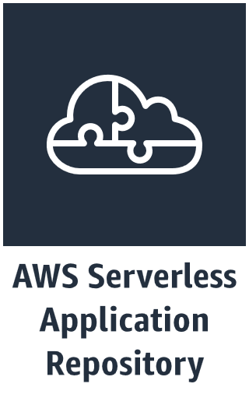
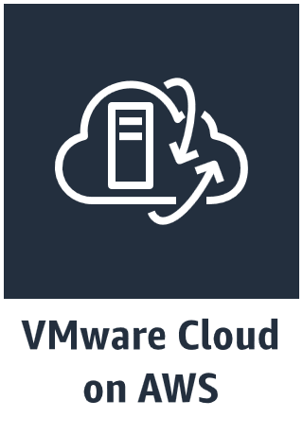



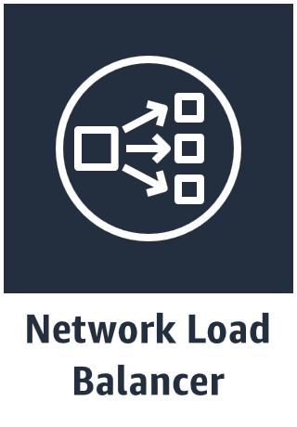
Compute
Lambda Function

Slide 26




Customer Engagement
Email

Slide 27













Database
Attribute
Item
Attributes
Items
Global secondary index
Table
Cache node

Slide 28
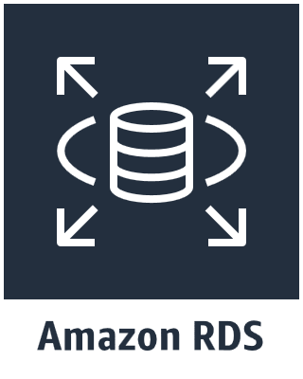















Database
DB Instance
DB instance standby
DB instance read replica
PIOP
MS SQL instance
MS SQL instance alternate
MySQL DB instance
MySQL DB instance alternate
Dense compute node
Database migration workflow/job
Oracle DB instance
Oracle DB instance alternate
SQL primary
SQL replica
Dense storage node
PostgreSQL instance

Slide 29



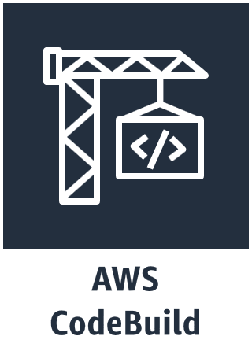
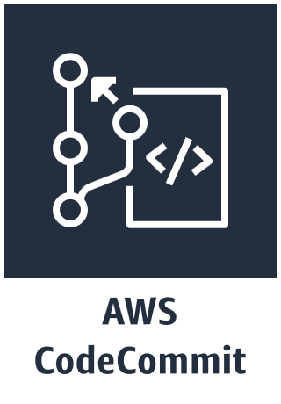
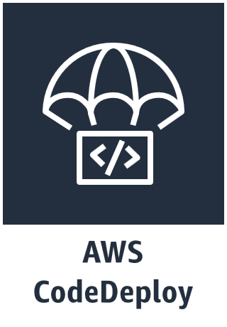
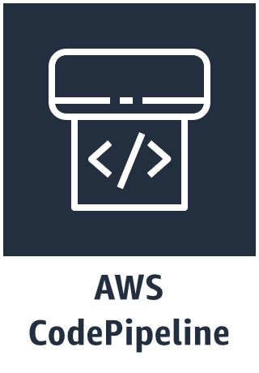
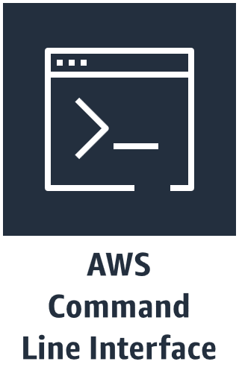

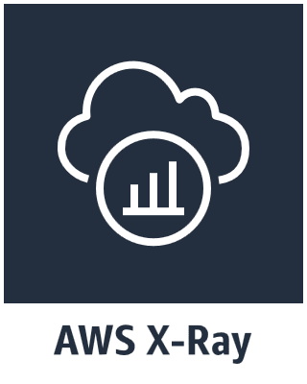

Desktop & App Streaming
Developer Tools
Game Development

Slide 30



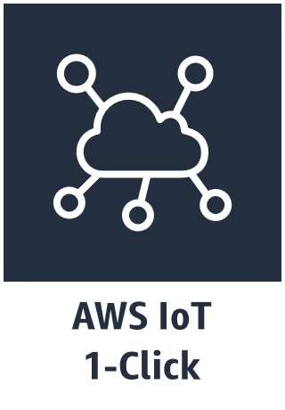





















Internet of Things
IoT Things
Bank
Bicycle
Camera
Car
Cart
Coffee pot
Door lock
Factory
Generic
House
Lightbulb
Medical Emergency
Police Emergency
Thermostat
Travel
Utility
Windfarm

Slide 31






























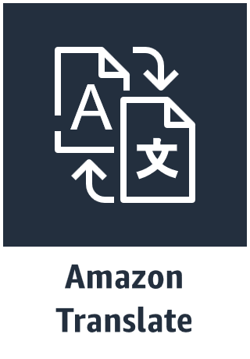

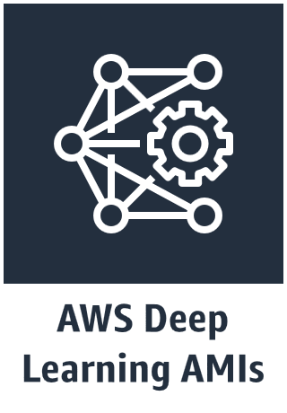

IoT Resources
Action
Actuator
Alexa enabled device
Alexa skill
Alexa smart home skill
Alexa voice service
Certificate manager
Desired state
Echo
FireTV stick
FireTV
Hardware board
HTTP/2 protocol
HTTP protocol
Lambda function
MQTT protocol
Policy
Reported state
Rule
Sensor
Servo
Shadow
Simulator
Topic
Machine Learning

Slide 32


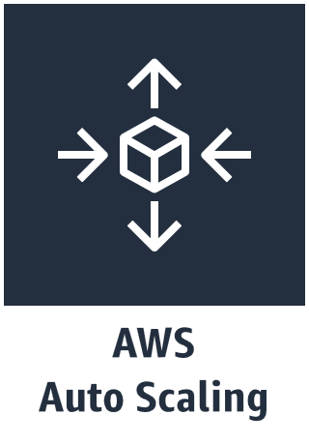



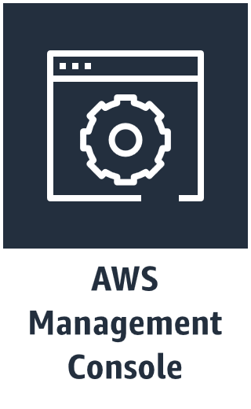

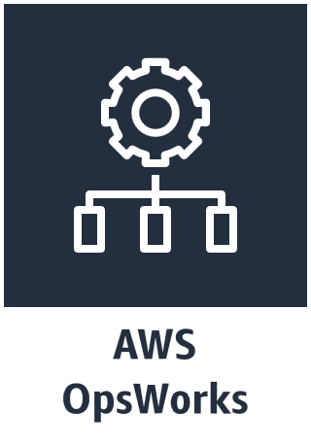














Management Tools
Alarm
Event (event-based)
Change set
Apps
Deployments
Instances
Event (time-based)
Stack
Layers
Monitoring
Permissions
Rule
Template
Resources
Stack2

Slide 33
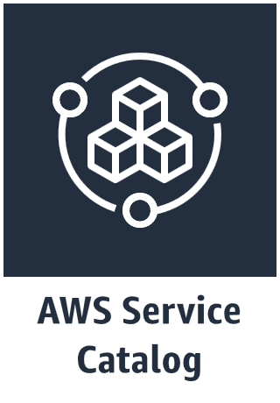

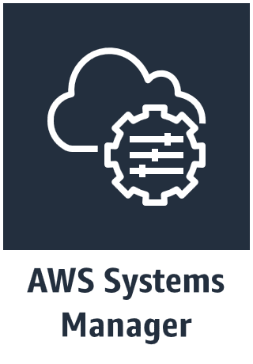




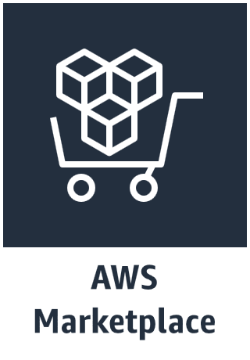










Management Tools
Automation
Documents
Checklist cost
Inventory
Maintenance windows
Checklist fault tolerant
Checklist performance
Parameter Store
Patch manager
Checklist security
Checklist
Run command
State manager

Slide 34

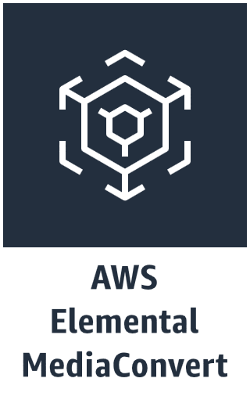
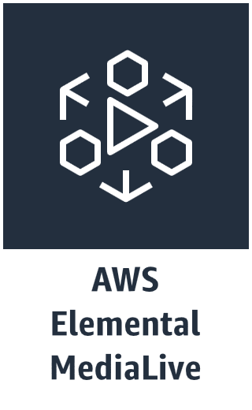

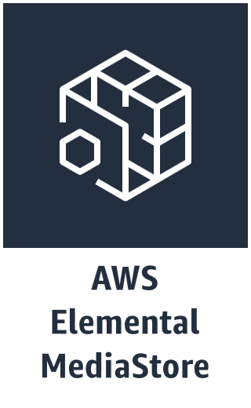






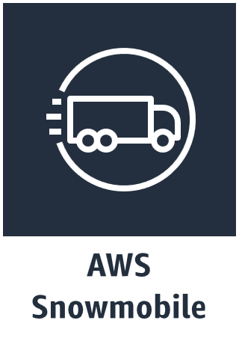
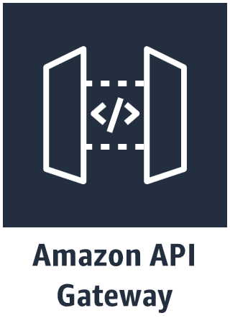


Media Services
Migration
Mobile Services

Slide 35







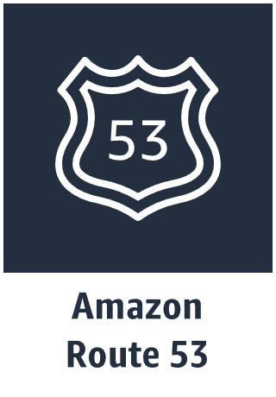






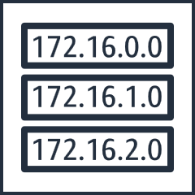






Network & Content Delivery
Customer gateway
Elastic network adapter
Elastic network interface
Endpoints
Flow logs
Internet gateway
NAT gateway
Network access control list
Download distribution
Hosted zone
Route table
Edge location
Peering
Router
VPN Connection
VPN Gateway
Streaming distribution

Slide 36
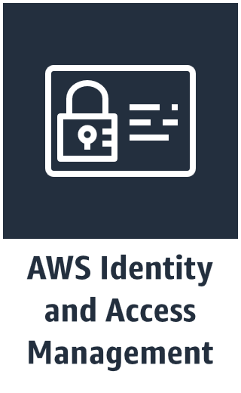




















Security, Identity, & Compliance
Add-on
AWS STS
Data encryption key
Encrypted data
Agent
AWS STS (alternate)
Certificate manager
Long-term security credential
MFA token
Permissions
Temporary security credential
Role

Slide 37
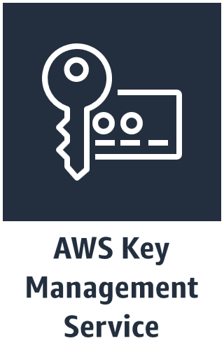





Security, Identity & Compliance
Filtering rule

Slide 38
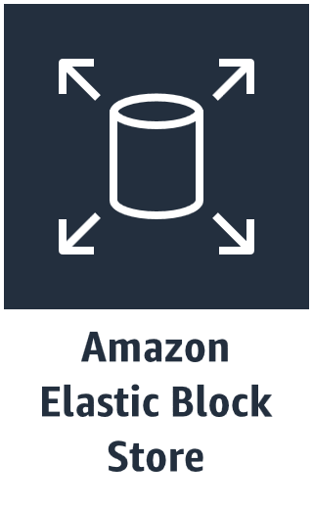


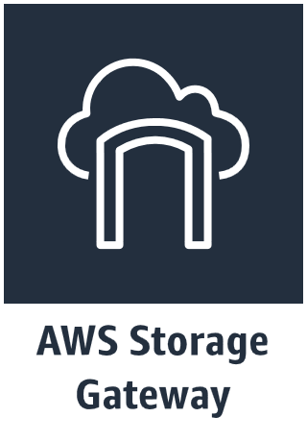











Storage
Bucket
Snapshot
Archive
Import/export
Cached volume
Bucket with objects
Vault
Volume
Non-cached volume
Object
Virtual tape library

Slide 39
Examples
The system in action

Slide 40
Example 1:
Couchbase on AWS
AWS Cloud
AWS Region
VPC
Availability zone 1
Availability zone 2
Public subnet
Public subnet
NAT gateway
NAT gateway
Auto Scaling group
Couchbase Sync Gateway
Couchbase Sync Gateway
Auto Scaling group
Couchbase Server
Couchbase Server

Slide 41

Example 2:
AWS Connected Vehicle Solution
Anomaly detection
Raw data
Trip data
Driver safety score
Notification service
Connected vehicles with AWS Greengrass Core
Diagnostic trouble codes
Just-in-time registration
Location-based marketing

Slide 42
Example 3:
Git to S3 Webhooks
AWS Cloud
Region
Amazon S3 SSH key bucket
3rd party Git repository
Git Push
Git webhook
Git users
AWS KMS key
Amazon S3 output bucket

